Slide 1

DEIS
Delivering Equality of Opportunity in Schools

Slide 2
Today’s Focus
What is DEIS and why is it so important?
Whats the St Pauls Context?
Outline the next steps for creating the new DEIS plan 2024-2027.

Slide 3
DEIS?
DEIS is aimed at addressing the needs of children and young people from disadvantaged communities
(Delivering Equality of Opportunity in Schools, 2005)

Slide 4
Some of the resources for DEIS Schools
Additional grant aid based on level of disadvantage.
Enhanced guidance allocation
Enhanced rate of funding under School Books Grant Scheme and other grants
Access to Home School Community Liaison (HSCL) services.
Access to range of supports under School Completion Programme
Access to BfL teacher
Access to planning supports
Access to a range of professional development supports through Oide, the new integrated support service for teachers and school leaders (formerly PDST, CSL, JCT and NIPT). www.oide.ie

Slide 5

DEIS Plan 2017
The DEIS plan 2017 replaces the Action Plan launched in 2005 and sets out a vision for future intervention in the critical area of social inclusion.

Slide 6
DEIS Action Planning for Improvement
The DEIS action plan requires post-primary DEIS schools to have three-year action plans for improvement…
A DEIS school action plan is its school improvement plan for the purposes of school self-evaluation, and no additional or separate improvement plan is required.
The six step School Self evaluation Process remains the same.
Teaching and learning is the core activity of all schools, including DEIS schools.

Slide 7
DEIS in St. Paul’s
Awarded DEIS status is 2007
Evaluation for Action Planning in DEIS schools carried out in 2023
Inspection activities undertaken: Interview with principal and relevant staff, Examination of school’s current action plans for improvement, Observation of DEIS-related activities and interventions, Student focus-group meeting, Parent focus-group meeting, Analysis of parent and student questionnaires, Observation of teaching and learning, Examination of students’ work, Interaction with students, Feedback to principal and relevant staff

Slide 8
DEIS Evaluation Report 2023
Feedback
“The quality of leadership of DEIS action planning was exemplary”
“Highly effective whole-school structures”

Slide 9
DEIS in St. Paul’s
Strands in St. Paul’s:
Attendance
Retention
Literacy
Numeracy
Attainment
Transition (Progression)
Partnership with Parents and Others.

Slide 10
Leading DEIS Planning: A Data & Research-Informed Approach -
Looking at the WHY behind DEIS planning and DEIS themes.
How to work collaboratively for DEIS planning.
Identifying appropriate data to inform DEIS planning.
How to gather concise and effective data.
How to analyse data effectively.
Using data to inform target setting and action planning.
What research says about putting together effective improvement plans.
How to lead successful change initiatives in schools.

Slide 11
Key aspects for each Strand
Target Setting: involves gathering data and evidence, analysing it, and using information to formulate targets that are SMART: specific, measurable, attainable, realistic, and time-bound.
Selection of strategies: focus is on how the targets will be attained. An effective planning process makes clear links between target-setting and the selection of strategies and interventions to achieve targets set.
Implementation of strategies: focus is on how the strategies and interventions selected are put into practice. Effective planning means that a whole-school approach to implementation is evident.
Impact and progress: Schools are required to monitor the effectiveness of the strategies they are implementing. Schools should be able to show that outcomes have improved, or that they have adjusted targets or strategies having reviewed the progress made.

Slide 12
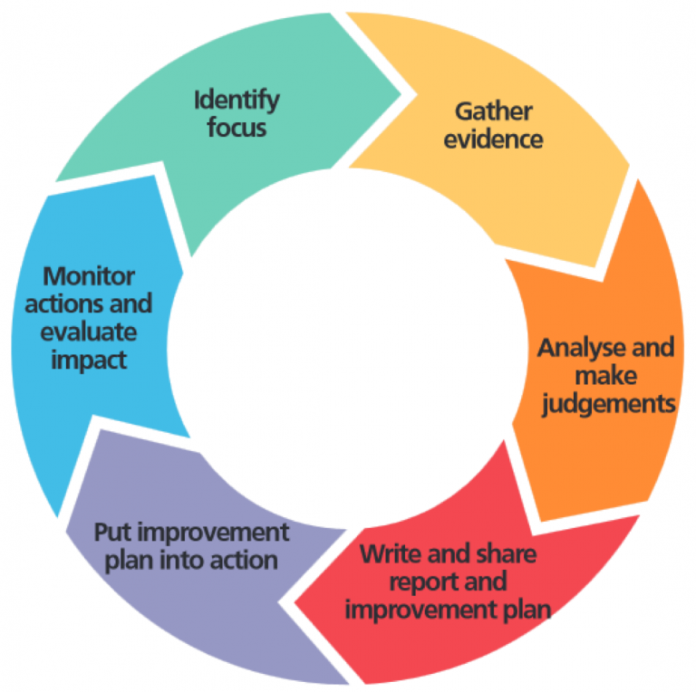

Slide 13
Whole School Approach
All staff need to be aware of DEIS targets and should be included in Subject Dept Planning
Staff have a responsibility to ensure that DEIS targets are met
Staff must familiarise themselves with the DEIS initiatives that are run in the school and how effective they are.

Slide 14
What now?
This school year is the first year of a three year action plan for improvement.
Each strand needs to submit a new plan.
Targets, actions and measures for each strand need to be reviewed, assessed and adjusted if necessary.
Analysis of the data should occur to see if the targets have been met.
Strands will work off the most recent data that they have but a three year rolling average is necessary.
New SMART targets then need to be set for the coming year.

Slide 15
Continued….
Actions and measures need to be agreed upon as to you we can meet these targets.
Promotion of the work done in your strand.
New Tabs created on the website to be populated (thanks Seamus!)

Slide 16
DEIS Strand Structure/Roles
Role 1 - Leader & Deputy Leader: Takes responsibility for the strand
Role 2 - Statistics & Targets: Uses gathered information to formulate SMART targets
Role 3 - Initiatives: Sets strategies and interventions to achieve set targets
Role 4 - PRO: Promotes any initiatives or information (noticeboards, school website, social media, etc…)
Role 5 - Monitoring & Evaluation: Monitors strategies that are being implemented and evaluates their effectiveness

Slide 17
AGENDA FOR PLANNING TODAY.
Strands to work together in their groups.
Assigning roles.
Updating plan.
Analysis of data.
Review of targets and setting new targets for next 3 years.
Review of Actions to make them more focused on the individual strands
Creating a blurb for the website on your strand with a mention of one or two key targets that you will focus on for the year.

